Slide 1

CSYE 7200
Final Presentation
Xuanshan Xiao
Lei Liu

Slide 2
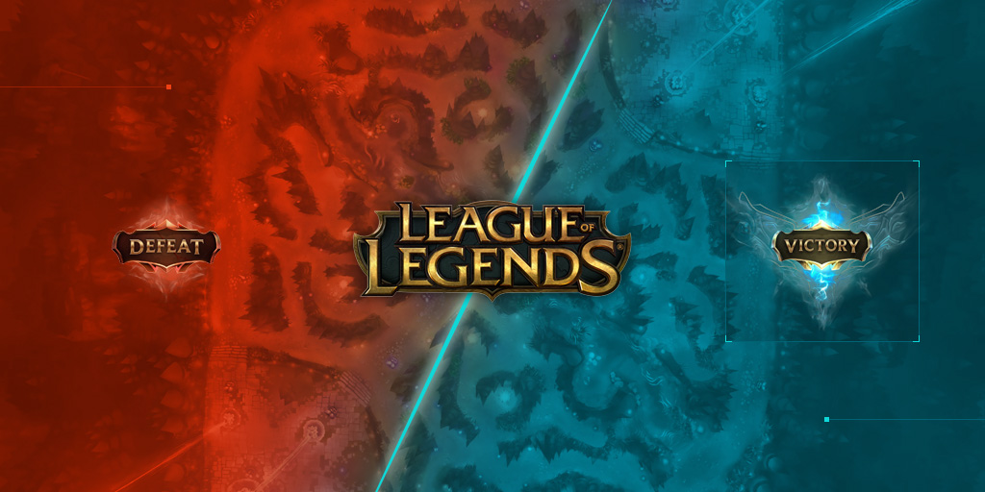
Short Intro
2 Teams
2 Spells Each Champion
5 Abilities Each Champion
10 Champions in Battle
Kill / Death / Assistant
Level In Ranked Game

Slide 3
Game Analysis
The result of a game will be influenced by many factors
First tower
First kill
Baron kills
Drake kills
etc.
Champions Pick is the only factor that influence the result of the game before it starts

Slide 4
Data Source
Collect Summoners Name from na.opgg.com
Collect data from official Riot API: https://developer.riotgames.com/api-methods/
Including:
Summoner Account Info (Encrypted Account ID)
Summoner Champion Mastery
Match Info (Champions and Results)
Ability Attributes (Passive, 4 Abilities on damage, displacement etc.)

Slide 5
Data Source
Request with riot api
HTML from op.gg with Future
RDD to parallelize process
Account Info
Match ID
Summoner Name
Champion Mastery Info
Match Info

Slide 6
Data Collected
Before Data Cleaning:
Match Info: 100,000+
Account Info: 10,000+
Champion Mastery: 100,000+
After Data Cleaning:
Match Info: 60,000+

Slide 7
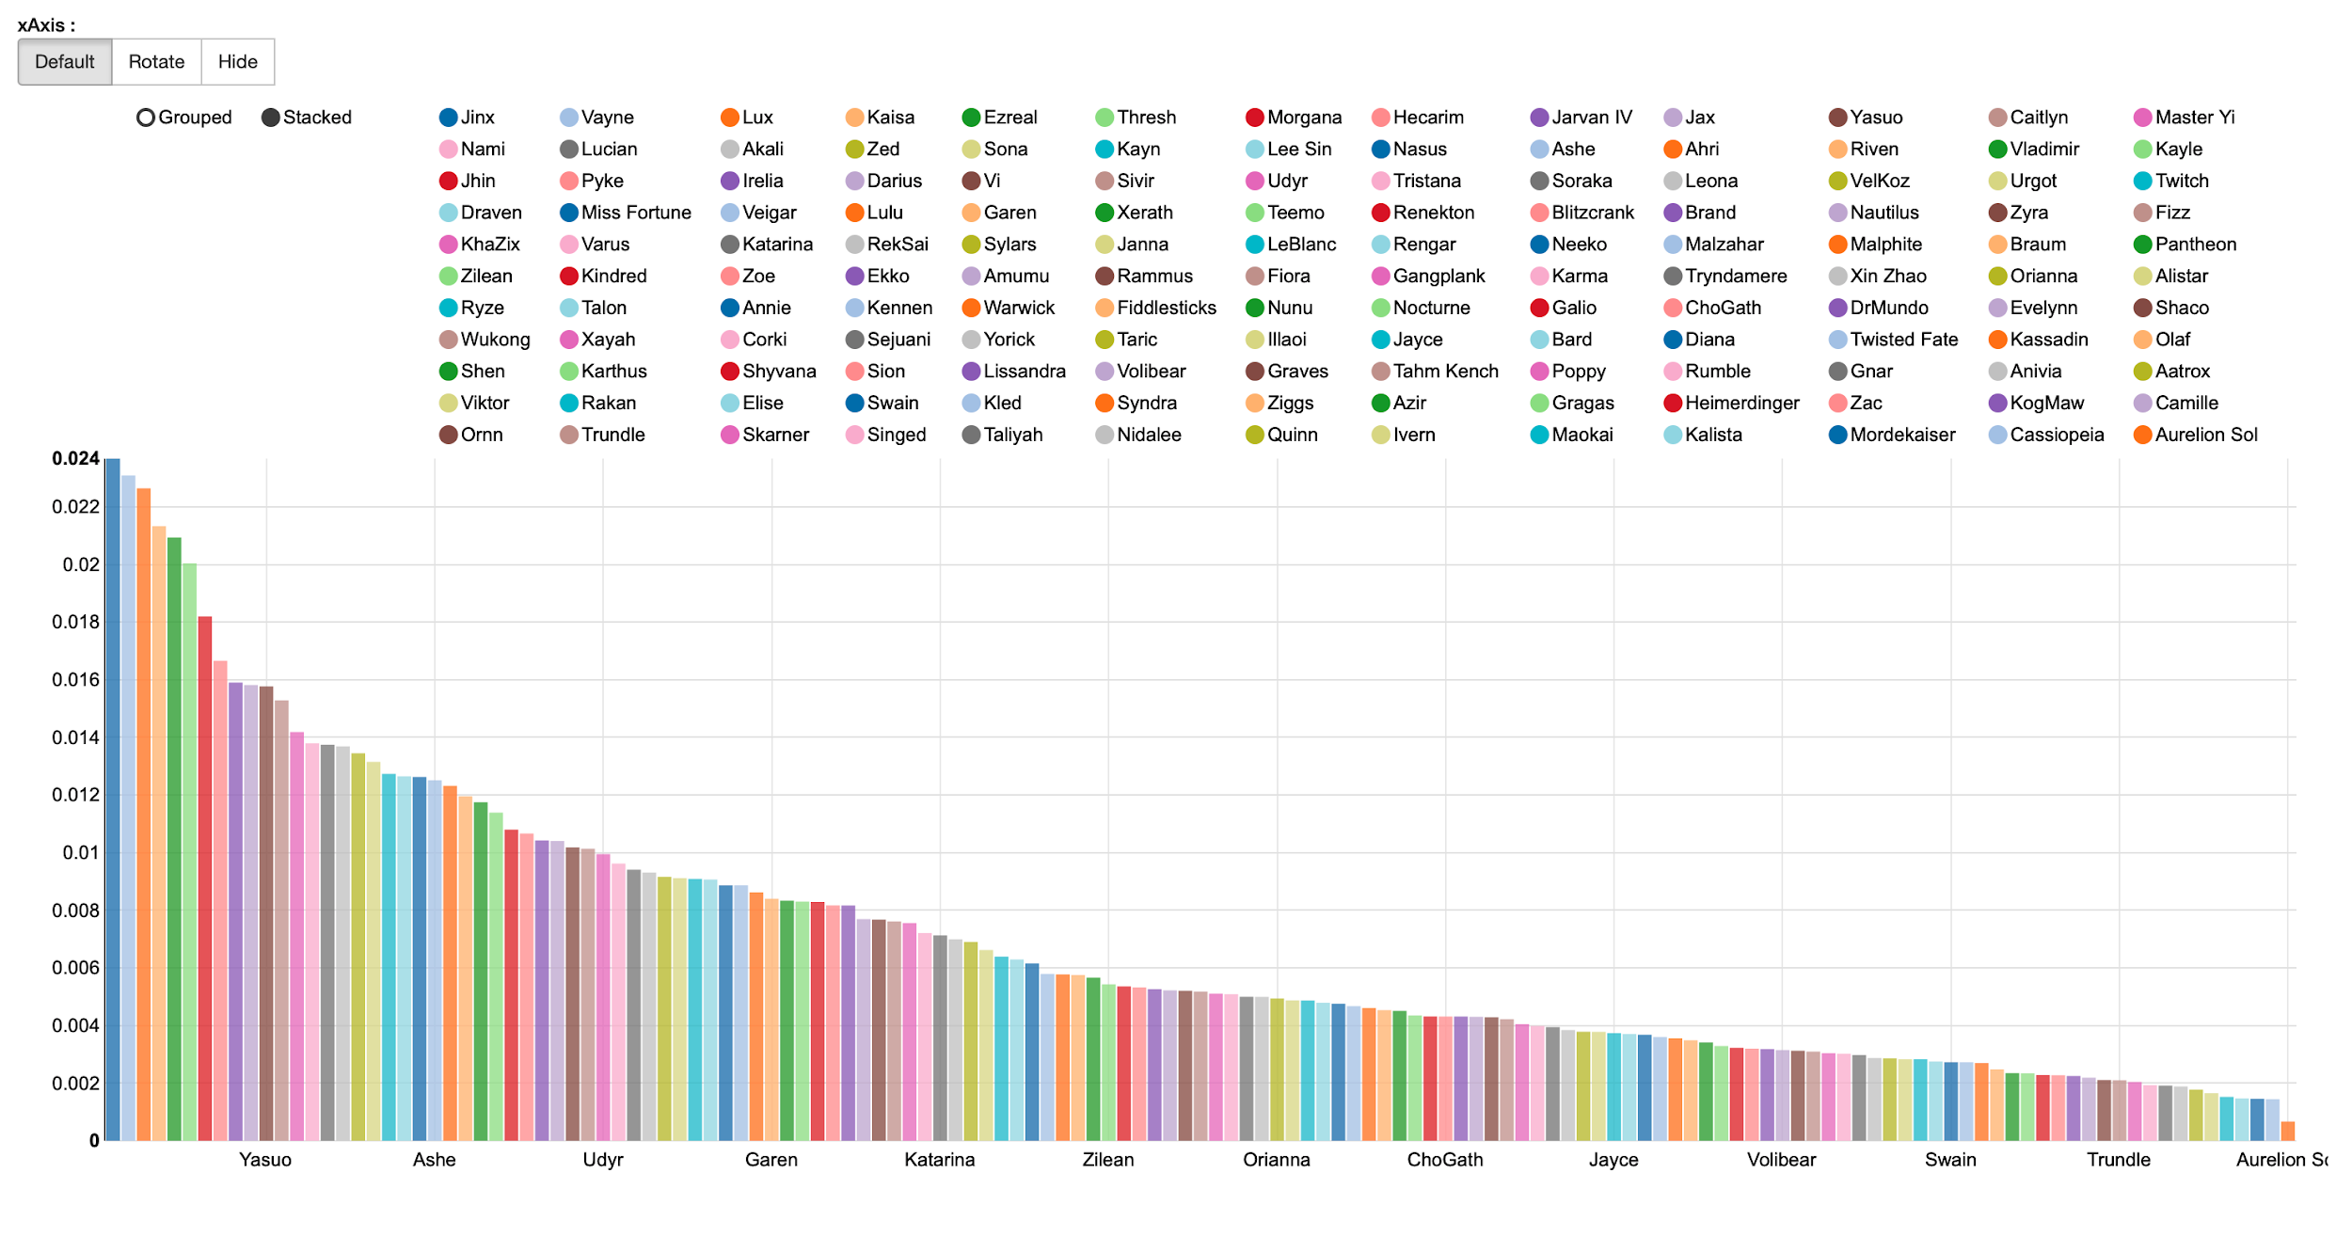
Data Analysis
Pick Rate

Slide 8
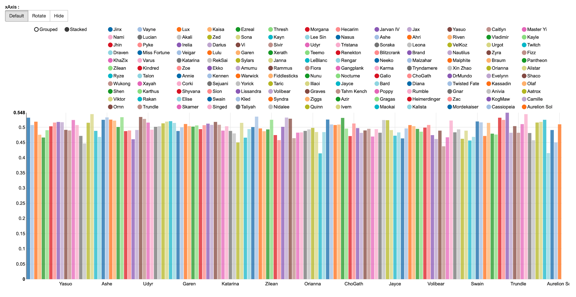
Data Analysis
Win Rate - ordered by pick rate

Slide 9
Prediction
Methodology
Spark MLlib, Spark SQL DataFrame
ANN
Model Analysis & Accuracy
Layers: 500 -> 200 -> 100 -> 70 -> 30 -> 15 -> 2
With 60,986 rows of data
Highest accuracy: 0.61

Slide 10
API & Function
Given 9 champions, system can give the champion that is with the highest win rate
E.g.
Input:
150,0,157,29,161 | 75,203,7,110,43
Recommendation:
(39,0.7225301178126661)

Slide 11
API & Function
Given any number of champions, system will give recommendations on champion pick. (based on Genetic Algorithm)
E.g.
Input:
150,0,0,29,0 V.S. 75,0,7,0,43
Recommendation:
150,20,157,29,161 V.S. 75,203,7,110,43

Slide 12
End
Xuanshan Xiao
Lei Liu

